Slide 1
NLP | Business Case: Automated Customer Reviews
Mohammed Alhazmi

Slide 2
Task1-Review Classification
Objective: Classify customer reviews into positive, negative, or neutral categories to help the company improve its products and services.
Task: Create a model for classifying the textual content of reviews into these three categories.

Slide 3
Methodology
Data Cleaning & Preparation
Class Balancing
Tokenization
Dataset Construction
Model Training
Deployment

Slide 4
Text Preprocessing
Applied a custom clean_text() function:
Lowercased text
Removed HTML tags and special characters
Normalized whitespace
Sentiment classification of review descriptions based on the star rating:
1–2 stars → Negative
3 stars → Neutral
4–5 stars → Positive

Slide 5
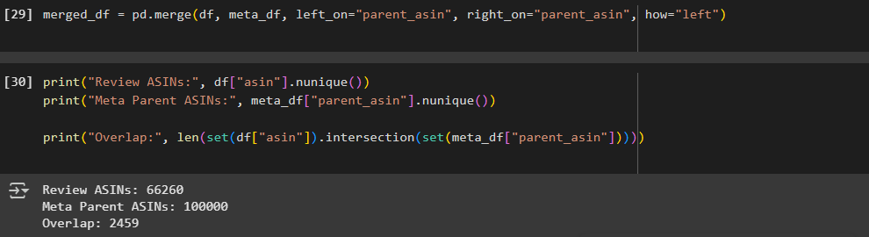
Data Cleaning & Preparation
Merged two datasets:
df containing review-related metadata(users)
meta_df containing parent_asin, description, main_category, etc
(items).
Joined using parent_asin as the key

Slide 6
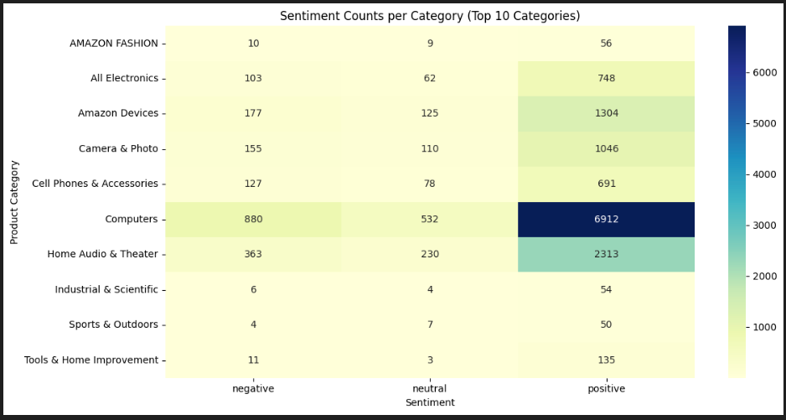
Class Balancing

Slide 7
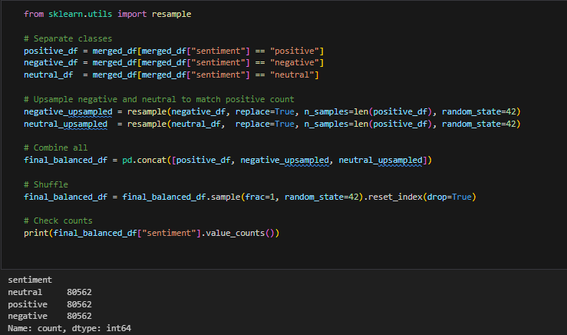
Class Balancing

Slide 8
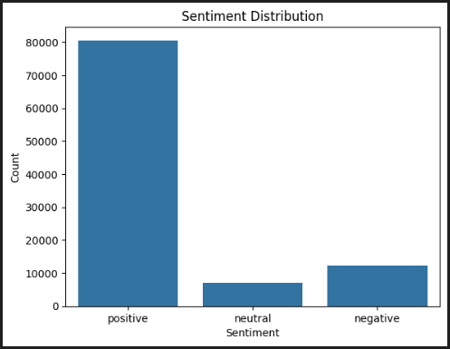
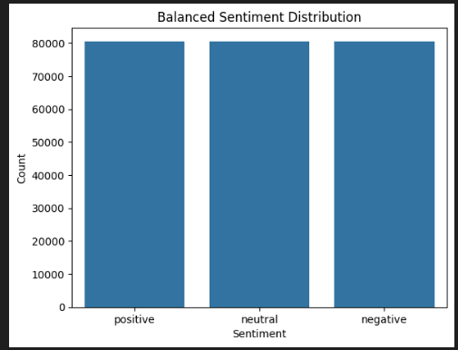
Class Balancing

Slide 9
Tokenization & Training
Tokenization
Used RoBERTa tokenizer (roberta-base) to process the description text
Applied truncation and padding with max sequence length of 128 tokens
Dataset Construction
Built a custom PyTorch Dataset class for training and validation
Enabled Hugging Face Trainer to work seamlessly with encoded inputs
Model Training
Used RoBERTa-based model via AutoModelForSequenceClassification
Configured for 3 output labels (positive, neutral, negative)

Slide 10
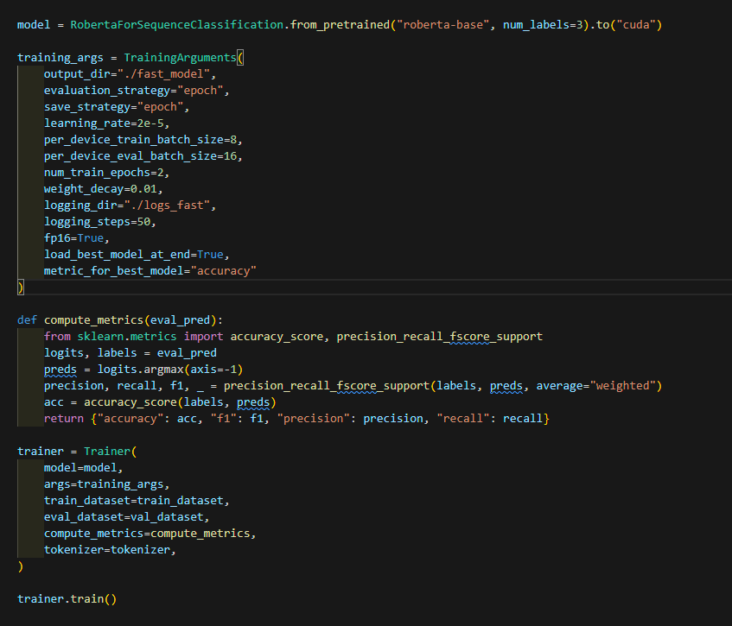
Training & Evaluation
Evaluation Results (after 2 epochs):
Evaluation Loss: 0.3379
Accuracy: 90.16%
F1 Score: 0.8982
Precision: 0.8956
Recall: 0.9016
Evaluation Runtime: 73.94 seconds
Samples/sec: 270.51
Steps/sec: 16.91
Training Summary:
Total Training Time: 2985.78 seconds
Training Samples/sec: 53.59
Training Steps/sec: 6.70
Final Training Loss: 0.3110
Epochs Completed: 2

Slide 11
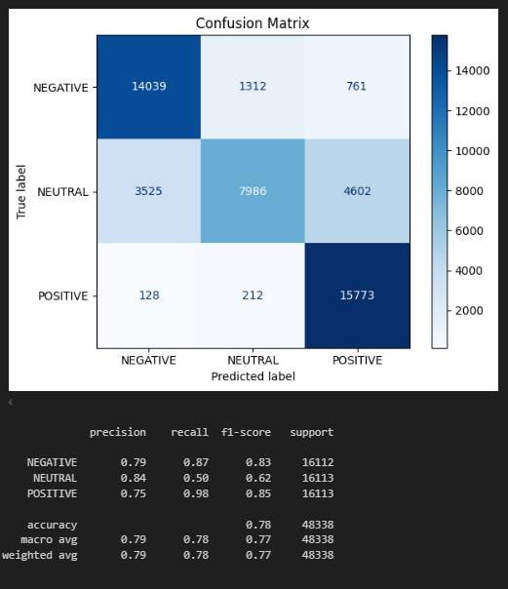
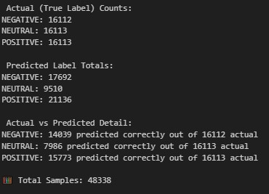
Results

Slide 12
Demo & Deployment
Loaded trained model + tokenizer.
Deployed via Gradio interface with live input.
Output format: "Sentiment Label (Confidence Score)"

Slide 13
Task-2 Product Category Clustering
Goal
Group product descriptions into broader clusters to better organize and analyze similar products.

Slide 14
Methodology
Input: Used the cleaned_title column as the base text for clustering
Feature Engineering
TF-IDF:
Captures word importance across product titles
Max features: 10,000 | N-grams: (1,3) | Min DF: 5 | Max DF: 0.8
SBERT (Sentence-BERT):
Used pretrained transformer model: all-MiniLM-L6-v2
Dimensionality Reduction:
Applied TruncatedSVD (similar to LSA) to reduce TF-IDF to 100 components
Clustering Algorithm:
Used KMeans clustering
Chose 5 clusters based on elbow method + domain logic

Slide 15
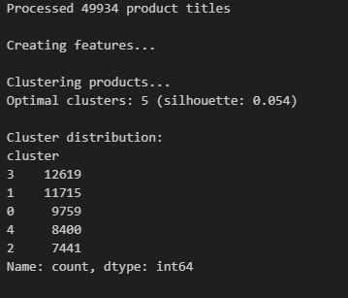
Result
Cluster 0 – 📸 Photography & Video Equipment
Top keywords: camera, lens, backdrop, photo, mount, tripod
Cluster 1 – 💻 Computers & Hardware
Top keywords: laptop, usb, drive, ram, ssd, intel, window
Cluster 2 – 🎧 Audio & Bluetooth Devices
Top keywords: headphone, bluetooth, speaker, ear, wireless, mic
Cluster 3 – 📱 Tablet & Phone Cases
Top keywords: case, cover, ipad, tablet, macbook, screen protector
Cluster 4 – 🔌 Cables & Chargers
Top keywords: cable, adapter, usb, charger, hdmi, power

Slide 16
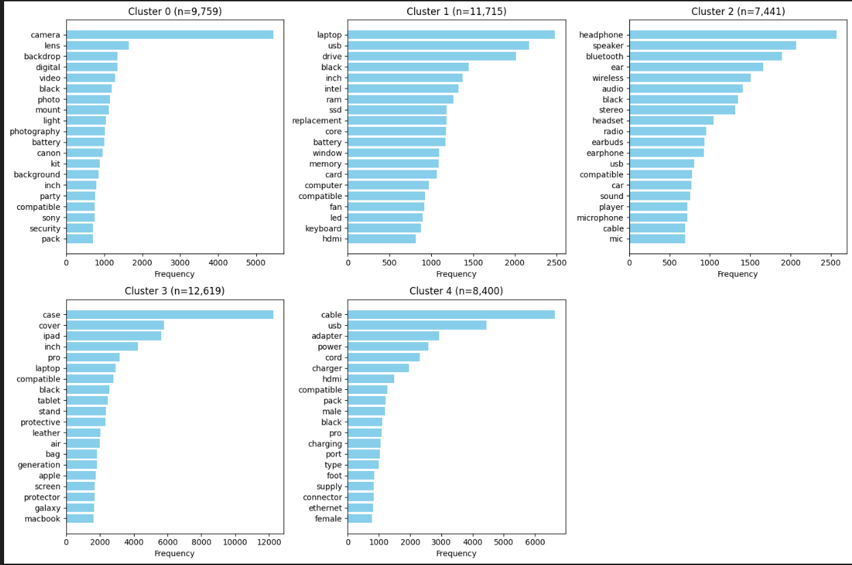
Result & visualizations

Slide 17
Improvements & Future Work
Model Limitation:
KMeans assumes spherical clusters and equal variance, which may not capture
complex structures in semantic product data.
Suggested Alternative:
Try Hierarchical Clustering for better flexibility:
Does not require predefining the number of clusters
Captures nested groupings and fine-grained category splits
Allows visualization with dendrograms to explore relationships between products
Advanced Options:
Experiment with HDBSCAN for density-based semantic clustering
Use topic modeling (e.g., BERTopic or LDA) to extract interpretable category topics

Slide 18
Task3-AI-Powered Product Summarization
Automatically generate structured summaries comparing top-rated products in each Amazon category using customer reviews.

Slide 19
Methodology
Data Merging: Combined user reviews with product metadata using parent_asin
Sentiment Analysis: Used DistilBERT (distilbert-base-uncased-finetuned-sst-2-english) to label each review as Positive, Neutral, or Negative
Ranking Products:
Score = 0.5 × Avg Rating + 0.3 × log(Review Count) + 0.2 × Positive Ratio
Selected Top 3 and Worst 1 per category
Complaint Extraction: Extracted common negative terms from poor reviews (e.g., “defective”, “broken”)
Structured Summarization: Generated markdown summaries with:
Header and Top 3 Products
Key Differences (manual/optional)
Product to Avoid
Final Recommendation

Slide 20
System Workflow (Flowchart)
[ Raw JSONL Reviews ] ──▶ [ Data Merge ] ──▶ [ Sentiment Analysis ]
│ │
▼ ▼
[ Product Ranking ] ──▶ [ Article Generator ] ──▶ [ .md Output + Console ]

Slide 21
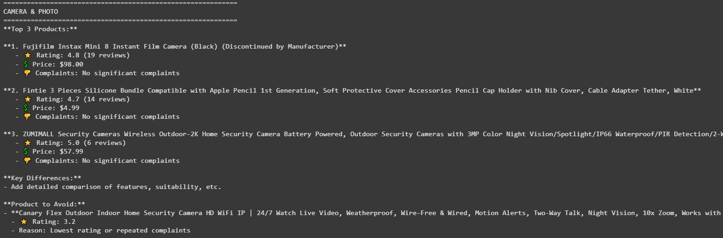
Result

Slide 22
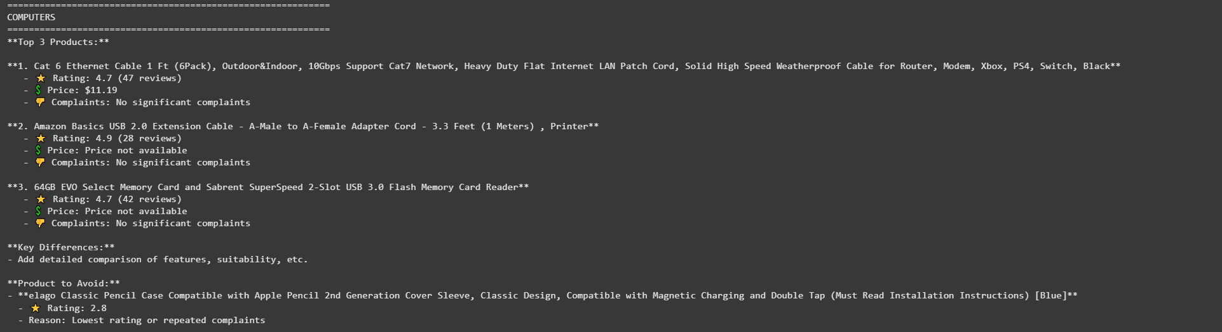
Result

Slide 23
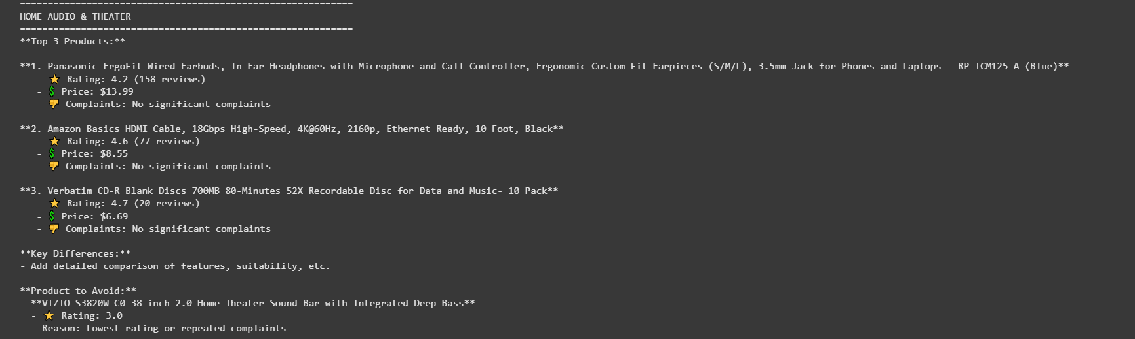
Result

Slide 24
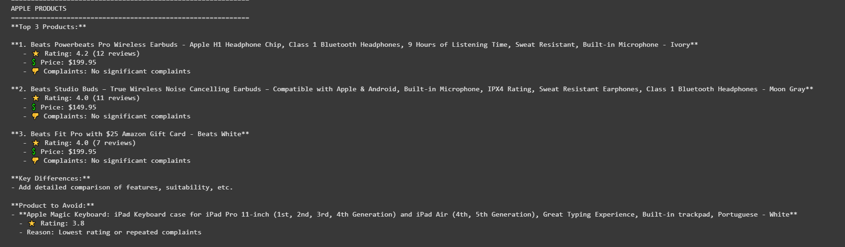
Result

